Slide 1
Digital to Analog Converters (DAC)

Slide 2
Digital to Analog Converters
  Performance Specifications
  Common Applications

Slide 3
Digital to Analog Converters
-Performance Specifications
Resolution
Reference Voltages
Settling Time
Linearity
Speed
Errors

Slide 4
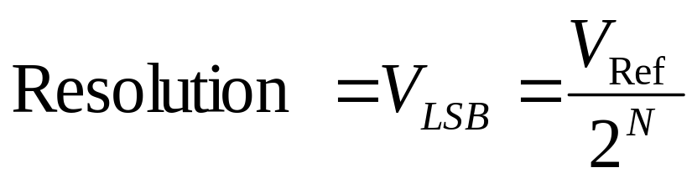
Digital to Analog Converters
-Performance Specifications
-Resolution
Resolution: is the amount of variance in output voltage for every change of the LSB in the digital input.
How closely can we approximate the desired output signal(Higher Res. = finer detail=smaller Voltage divisions)
A common DAC has a 8 - 12 bit Resolution
N = Number of bits

Slide 5
Digital to Analog Converters
-Performance Specifications
-Resolution
Poor Resolution(1 bit)
Better Resolution(3 bit)
Vout
Vout
Desired Analog signal
Desired Analog signal
111
110
110
2 Volt. Levels
1
8 Volt. Levels
101
101
100
100
011
011
010
010
001
001
0
0
000
000
Digital Input
Approximate output
Digital Input
Approximate output

Slide 6
Digital to Analog Converters
-Performance Specifications
-Reference Voltage
Reference Voltage: A specified voltage used to determine how each digital input will be assigned to each voltage division.
Types:
  Non-multiplier: internal, fixed, and defined by manufacturer
  Multiplier: external, variable, user specified

Slide 7
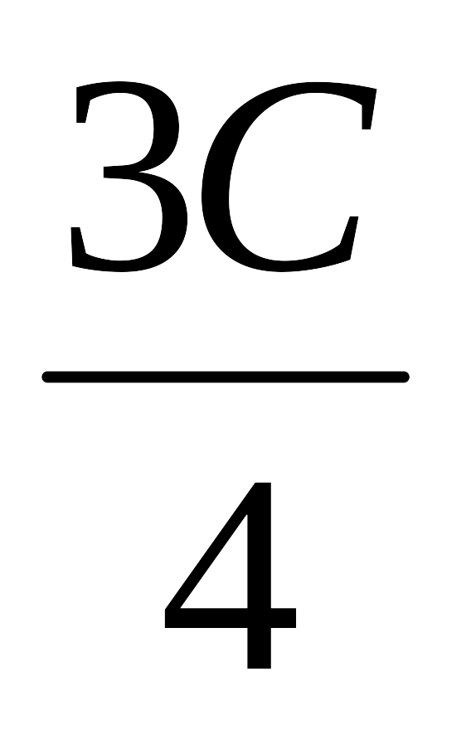
Digital to Analog Converters
-Performance Specifications
-Reference Voltage
Non-Multiplier: (Vref = C)
Multiplier: (Vref = Asin(wt))
Voltage
Voltage
11
11
10
10
10
10
01
01
01
01
0
0
00
00
00
00
Digital Input
Digital Input
Assume 2 bit DAC

Slide 8
Digital to Analog Converters
-Performance Specifications
-Settling Time
Settling Time: The time required for the input signal voltage to settle to the expected output voltage(within +/- VLSB).
Any change in the input state will not be reflected in the output state immediately. There is a time lag, between the two events.

Slide 9
Digital to Analog Converters
-Performance Specifications
-Settling Time
Analog Output Voltage
+VLSB
Expected Voltage
-VLSB
Time
Settling time

Slide 10
Digital to Analog Converters
-Performance Specifications
-Linearity
Linearity: is the difference between the desired analog output and the actual output over the full range of expected values.
Ideally, a DAC should produce a linear relationship between a digital input and the analog output, this is not always the case.

Slide 11
Digital to Analog Converters
-Performance Specifications
-Linearity
Linearity(Ideal Case)
NON-Linearity(Real World)
Desired/Approximate Output
Desired Output
Analog Output Voltage
Analog Output Voltage
Approximate output
Digital Input
Digital Input
Perfect Agreement
Miss-alignment

Slide 12
Digital to Analog Converters
-Performance Specifications
-Speed
Speed: Rate of conversion of a single digital input to its analog equivalent
Conversion Rate
  Depends on clock speed of input signal
  Depends on settling time of converter

Slide 13
Digital to Analog Converters
-Performance Specifications
-Errors
Non-linearity
  Differential
  Integral
Gain
Offset
Non-monotonicity

Slide 14
Digital to Analog Converters
-Performance Specifications
-Errors: Differential Non-Linearity
Differential Non-Linearity: Difference in voltage step size from the previous DAC output (Ideally All DLN’s = 1 VLSB)
Ideal Output
Analog Output Voltage
Diff. Non-Linearity = 2VLSB
2VLSB
VLSB
Digital Input

Slide 15
Digital to Analog Converters
-Performance Specifications
-Errors: Integral Non-Linearity
Integral Non-Linearity: Deviation of the actual DAC output from the ideal (Ideally all INL’s = 0)
Ideal Output
Analog Output Voltage
Int. Non-Linearity = 1VLSB
1VLSB
Digital Input

Slide 16
Digital to Analog Converters
-Performance Specifications
-Errors: Gain
Gain Error: Difference in slope of the ideal curve and the actual DAC output
High Gain
High Gain Error: Actual slope greater than ideal
Desired/Ideal Output
Low Gain Error: Actual slope less than ideal
Analog Output Voltage
Low Gain
Digital Input

Slide 17
Digital to Analog Converters
-Performance Specifications
-Errors: Offset
Offset Error: A constant voltage difference between the ideal DAC output and the actual.
  The voltage axis intercept of the DAC output curve is different than the ideal.
Output Voltage
Desired/Ideal Output
Positive Offset
Digital Input
Negative Offset

Slide 18
Digital to Analog Converters
-Performance Specifications
-Errors: Non-Monotonicity
Non-Monotonic: A decrease in output voltage with an increase in the digital input
Desired Output
Non-Monotonic
Analog Output Voltage
Monotonic
Digital Input

Slide 19
Digital to Analog Converters
-Common Applications
Generic use
Circuit Components
Digital Audio
Function Generators/Oscilloscopes
Motor Controllers

Slide 20
Digital to Analog Converters
-Common Applications
-Generic
Used when a continuous analog signal is required.
Signal from DAC can be smoothed by a Low pass filter
Piece-wise Continuous Output
Analog Continuous Output
Digital Input
n bit DAC
0 bit
011010010101010100101
101010101011111100101
000010101010111110011
010101010101010101010
111010101011110011000
100101010101010001111
Filter
n^{th} bit

Slide 21
Digital to Analog Converters
-Common Applications
-Circuit Components
Voltage controlled Amplifier
  digital input, External Reference Voltage as control
Digitally operated attenuator
  External Reference Voltage as input, digital control
Programmable Filters
  Digitally controlled cutoff frequencies

Slide 22
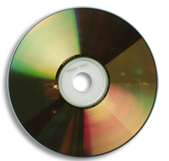
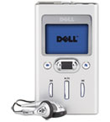
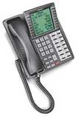
Digital to Analog Converters
-Common Applications
-Digital Audio
CD Players
MP3 Players
Digital Telephone/Answering Machines
1
2
3
1. http://electronics.howstuffworks.com/cd.htm
2. http://accessories.us.dell.com/sna/sna.aspx?c=us&cs=19&l=en&s=dhs&~topic=odg_dj
3. http://www.toshiba.com/taistsd/pages/prd_dtc_digphones.html

Slide 23
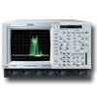
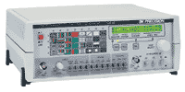
Digital to Analog Converters
-Common Applications
-Function Generators
Digital Oscilloscopes
  Digital Input
  Analog Ouput
Signal Generators
  Sine wave generation
  Square wave generation
  Triangle wave generation
  Random noise generation
1
2
1. http://www.electrorent.com/products/search/General_Purpose_Oscilloscopes.html
2. http://www.bkprecision.com/power_supplies_supply_generators.htm

Slide 24
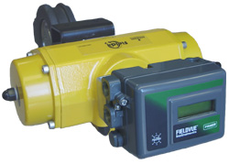
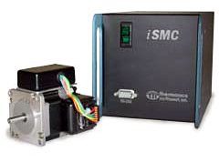
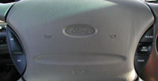
Digital to Analog Converters
-Common Applications
-Motor Controllers
Cruise Control
Valve Control
Motor Control
1
2
3
1. http://auto.howstuffworks.com/cruise-control.htm
2. http://www.emersonprocess.com/fisher/products/fieldvue/dvc/
3. http://www.thermionics.com/smc.htm

Slide 25
References
Cogdell, J.R. Foundations of Electrical Engineering. 2nd ed. Upper Saddle River, NJ: Prentice Hall, 1996.
“Simplified DAC/ADC Lecture Notes,” http://www-personal.engin.umd.umich.edu/ ~fmeral/ELECTRONICS II/ElectronicII.html
“Digital-Analog Conversion,” http://www.allaboutcircuits.com.
Barton, Kim, and Neel. “Digital to Analog Converters.” Lecture, March 21, 2001. http://www.me.gatech.edu/charles.ume/me4447Spring01/ClassNotes/dac.ppt.
Chacko, Deliou, Holst, “ME6465 DAC Lecture” Lecture, 10/ 23/2003, http://www.me.gatech.edu/mechatronics_course/
Lee, Jeelani, Beckwith, “Digital to Analog Converter” Lecture, Spring 2004, http://www.me.gatech.edu/mechatronics_course/

